Slide 1
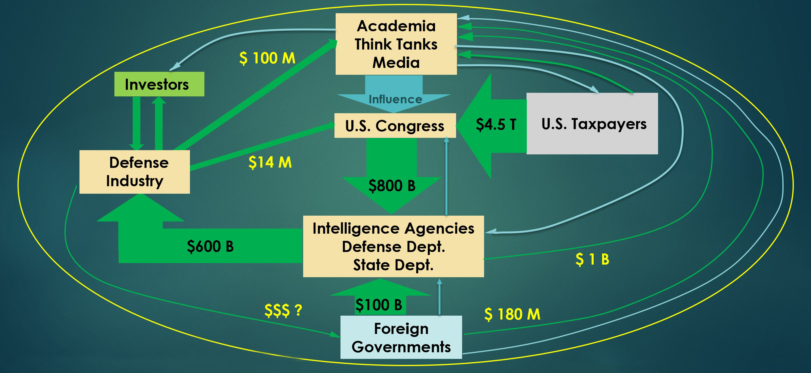
The Anatomy of the Blob
THE STRUCTURE OF AMERICA’S FOREIGN POLICY collective
HAIG HOVANESS
Co-chair, green party
peace action committee

Slide 2
What Is the Blob?
A powerful network of persons and institutions with convergent interests enabling a militaristic U.S. foreign policy
The ideology of the Blob is liberal hegemony, the aggressive propagation of democracy and free market economies
The Blob employs militaristic foreign policy to impose U.S. liberal hegemony on the world
Blob term origin: Ben Rhodes, Obama advisor, author of “The Worlds As It Is” 2018

Slide 3
Presentation Overview
Meet the Blob
Origins
Malignancy
Components
An Anatomical Model
Circulatory system = money
Nervous system = influence
Pathology = militaristic policy
Analysis and Reform
Vulnerable nodes
Opposition tactics
Prospects for change
Recommendations

Slide 4
Why Does the Blob Matter? The Blob pursues malignant policies
The Blob kills people and wrecks nations
The Blob increases the danger of nuclear war
The Blob diverts enormous resources from civil society
The Blob operates according to an ideology that does not acknowledge failure

Slide 5
Why Is the Blob’s Structure Important?
The Blob dominates Washington policy and has overwhelming financial, political, and media resources compared to peace activists
Successfully challenging the Blob requires determining where it is vulnerable
Vulnerabilities can be determined by understanding the anatomy of the Blob

Slide 6
Blob Origins and Evolution
Truman launches the national security state 1945-1950
Eisenhower farewell speech warning 1961
The early Blob – Military-Industrial Complex
From MIC to MICIMAT
Military-Industrial-Congressional-Intelligence-Media-Academic-Think Tank complex
Phase I rationale: Anti-Communism
Phase II rationale: Anti-Terrorism
Current Phase rationale: Anti-Authoritarianism
Governing ideology: militaristic pursuit of Liberal Hegemony

Slide 7
What Is U.S. Liberal Hegemony?
The U.S. is an exceptional nation
The U.S. has an historic duty to impose its political and economic model on the nations of the world
“Democratic” government (plutocracy)
“Free-market” economy (corporatocracy)
U.S. military supremacy needed to maintain order
U.S. “rules” supersede international law
In short: America’s elite control the world

Slide 8
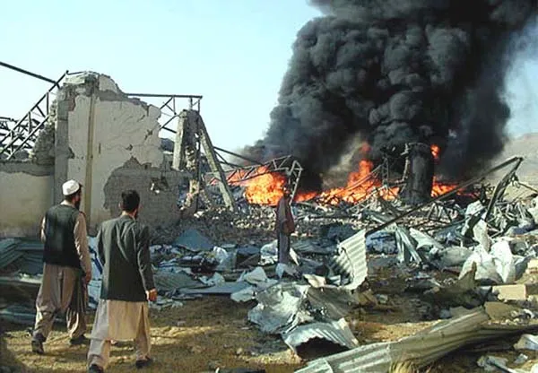
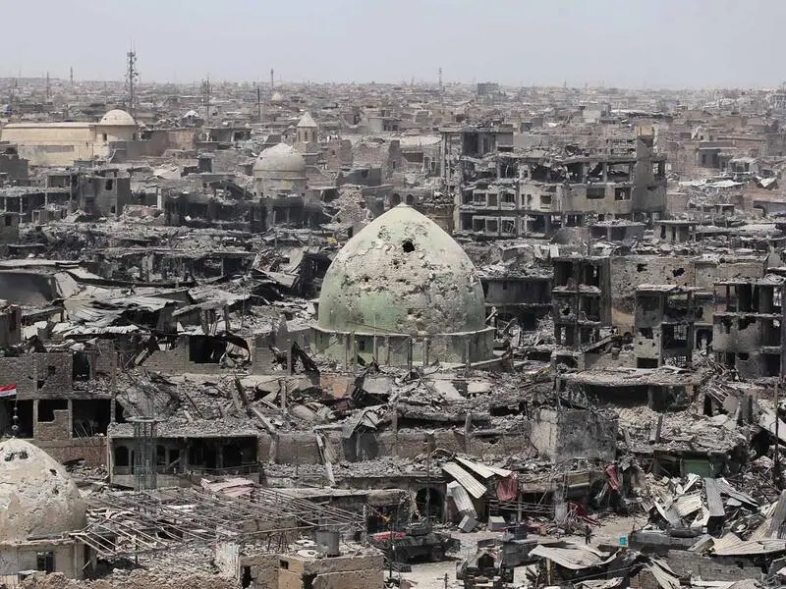
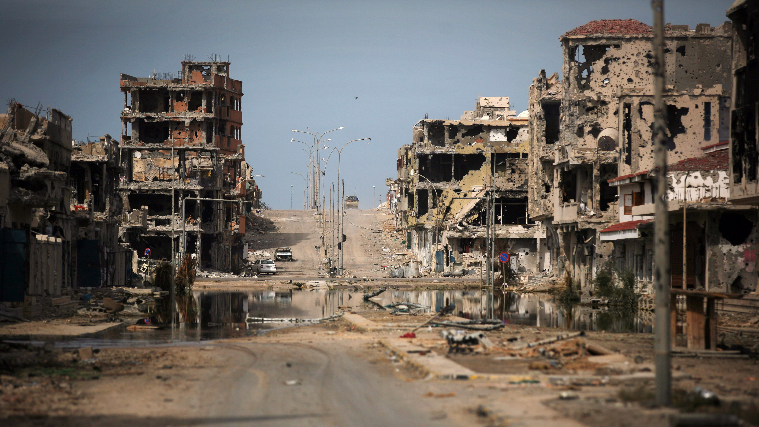
The Blob’s Greatest Hits
Afghanistan
Iraq
Libya
Syria
Ukraine

Slide 9
The Blob’s Failure in Afghanistan
America’s 20 year, $3 Trillion investment in Afghanistan ends in humiliating retreat, leaving a devastated and impoverished nation.
176,000 killed

Slide 10
The Blob’s Failure in Libya
The Blob’s attack on Libya transformed the most prosperous nation in Africa into a failed state wracked by civil war.
2,500 killed

Slide 11
The Blob’s Failure in Iraq
An illegal war of aggression, based on lies, inflicted enormous damage, ignited a civil war, strengthened the influence of Iran, and gave rise to ISIS, futher destabilizing the region
190,000 killed

Slide 12
The Blob’s Failure in Syria
A clandestine proxy war aimed at regime change devastated Syria, armed Islamic radicals, and encouraged Kurdish nationalists. Russian intervention preserved the regime, but the U.S. continues to illegally occupy portions of Syria, with no clear objectives.
307,000 killed

Slide 13
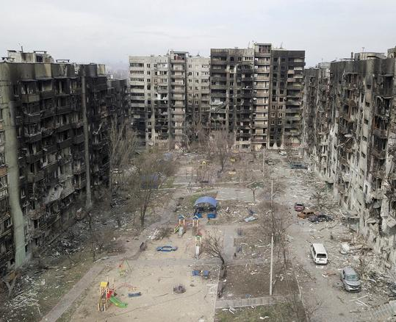
The Blob’s Failure in Ukraine (ongoing)
NATO moves to include Ukraine trigger devastating war
Economic sanctions resulting from war damaging EU and global economies
Risk of escalation to nuclear war
Russia driven into a strong alliance with China, creating a Eurasian hyper-power
> 30,000 killed

Slide 14
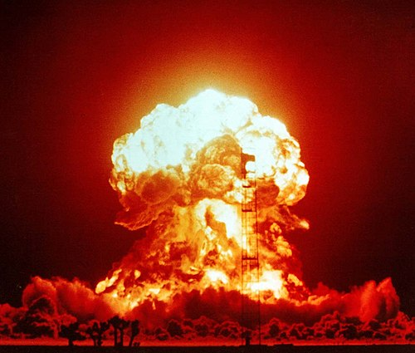
The Blob Increases the Risk of Nuclear War
Encouraging arms-racing (full-spectrum dominance)
Withdrawal from strategic arms control treaties
ABM
INF
Open Skies
Promotion of destabilizing weapons programs
Anti-Ballistic Missile systems
Anti-satellite weapons
Cyberwarfare
Tactical nuclear weapons

Slide 15
Naming the Parts of the Blob (MICIMAT)
Military
Intelligence agencies
Congress
Defense Industry
Media
Think Tanks
Notes:
Ray McGovern’s acronym

Slide 16
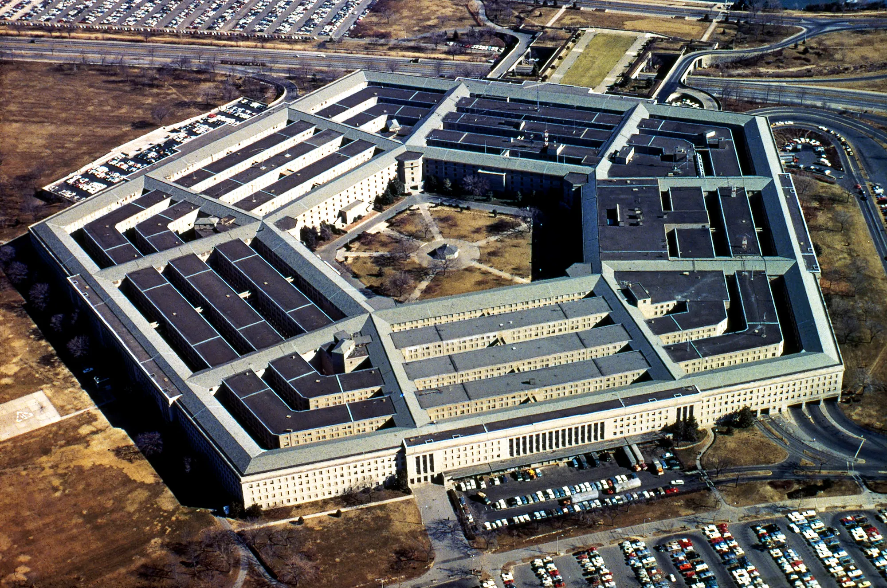
Naming the Parts of the Blob (MICIMAT)
Military
$800 Billion defense budget
Permanent war since 9/11
Active and retired officers increasingly influential
Expanding arms race (cyber and space weapons)
Generating “needs” for new weaponry
Global presence 800+ bases
Full Spectrum Dominance strategy

Slide 17
Naming the Parts of the Blob (MICIMAT)
Defense Industry
Steady growth
Poor accountability
Effective lobbying
Revolving door careers

Slide 18
Relative Size of Leading U.S. Corporations
Top 5 Defense | 2021 Revenue | Top 5 Non-Defense | 2021 Revenue
Lockheed-Martin | $64 Billion | Walmart | $573 Billion
Raytheon | $64 Billion | Amazon | $470 Billion
Boeing | $62 Billion | CVS Health | $292 Billion
General Dynamics | $38 Billion | Apple | $366 Billion
Northrup Grumman | $36 Billion | United Healthcare | $288 Billion
Defense corporations are a relatively small sector of the U.S. economy (5% of GDP), but their political influence dominates government defense expenditures, currently about $800 billion, which make up nearly half of the discretionary Federal budget

Slide 19
Naming the parts of the Blob (MICIMAT)
U.S. Congress
Controls the purse, funding government functions
Abdication of war powers
Faulty oversight of defense establishment
No significant distinction between major parties on defense issues

Slide 20
Naming the parts of the Blob (MICIMAT)
Intelligence agencies
Expansion beyond information gathering
Proliferation of agencies post 9/11
Politicization of intelligence
Erosion of civil liberties
Collapse of oversight
Mythologized in popular culture

Slide 21
Naming the Parts of the Blob (MICIMAT)
Media
Journalism
Hollywood
Social media

Slide 22
Naming the parts of the Blob (MICIMAT)
Academia
Graduate programs dominated by Blob ideology
Grooming process for Blob recruits
Professors provide expertise supporting Blob policies

Slide 23
Naming the parts of the Blob (MICIMAT)
Think Tanks
Dominated by Blob ideology
Declining research quality
Recycling area for former government personnel
Heavily funded by defense industry

Slide 24
Blob Think Tanks Dominate Policy Discourse
10 Most Influential Think Tanks
Organization | Blob-Aligned
Brookings Institution | Yes
Heritage Foundation | Yes
Council on Foreign Relations | Yes
Cato Institute | Yes
Center for Strategic and International Studies | Yes
American Enterprise Institute | Yes
RAND Corporation | Yes
Carnegie Endowment for International Peace | Yes
Atlantic Council | Yes
Hoover Institution | Yes

Slide 25
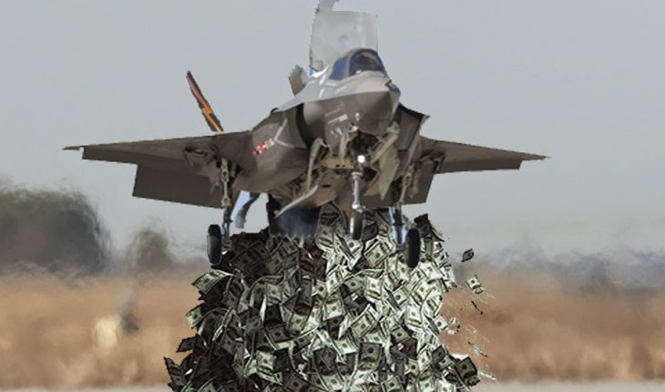
The Blob Diverts Resources from Civil Society and Harms the Environment
800+ military bases worldwide
U.S. military budget over $800 billion and growing
Military Keynesianism an unsound justification
Contractor corruption
U.S. military a top polluter
Superfund sites
Fossil fuel consumption

Slide 26
Is the Blob Held Accountable?
Name | Prior Activity | Current Position
Anthony Blinken | Supported U.S. invasion of Iraq | Secretary of State
Jake Sullivan | Involved in decisions resulting in war in Libya | National Security Advisor
Victoria Nuland | Involved in creation of pro-U.S. government in Ukraine | Under Secretary of State
Llyod Austin | Commanded forces in Iraq | Secretary of Defense
Mark Milley | Commanded forces in Afghanistan | Chairman of Joint Chiefs of Staff
Thomas Friedman | New York Times Op-Ed columnist supporting Iraq war | New York Times Op-Ed columnist supporting Ukraine war
Jeffrey Goldberg | Journalist supporting Iraq war | Chief Editor, Atlantic Magazine
Conclusion: The Blob remains firmly in control of U.S. foreign policy
Notes:
Blob members are so good at institutional politics that they can advance their careers irrespective of conspicuous failures

Slide 27
Anatomy of the Blob The Financial Circulatory System
Lobbyists
Think Tanks
Advertising/PR
$ 100 M
$SS ?
Investors
U.S. Taxpayers
US Congress
$4.5 T
Defense Industry
$14 M
$800 B
Defense Dept.
State Dept.
Military Services
$ 1 B
$600 B
$100 B
$$$ ?
$ 180 M
Foreign Governments

Slide 28
Anatomy of the Blob The Influence Nervous System
Lobbyists
Think Tanks
Media
Investors
Influence
Taxpayers
US Congress
Defense Industry
Defense Dept.
State Dept.
Military Services
Intelligence
Agencies
Foreign Governments

Slide 29
The Blob Influence Network
Military
Intelligence Agencies
Think Tanks
Academia
Congress
Defense
Industry
Media
Notes:
The dense mesh of influence links in the Blob makes it impervious to almost any attack. Each component is protected by other components with which they exchange influence credits.

Slide 30
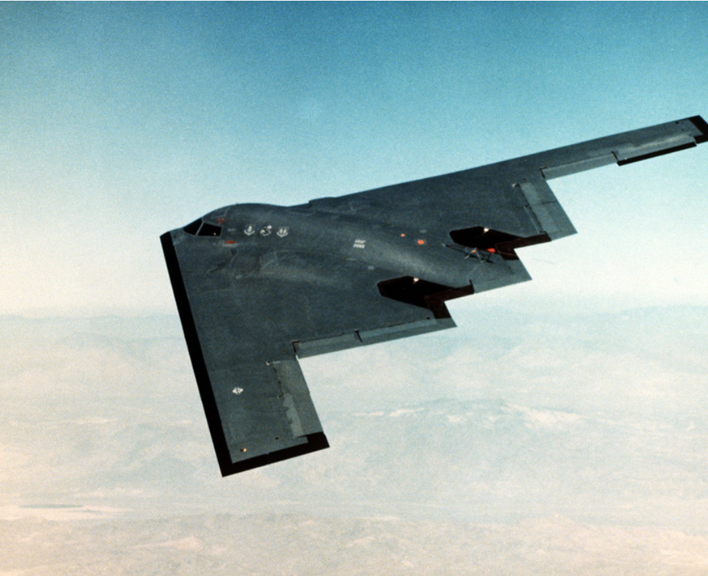
The Triumph of Stealthy Influence
Stealthy influence techniques
Marker trading (influence credits)
Deferred benefits
Cut-outs (use of intermediaries)
Revolving door careers
Nepotism
Notes:
The great triumph of stealth technology in America was not limited to military aviation; it was also evident in the sophisticated methods developed by Blob members to mask their efforts to advance their careers and pursue their policy objectives.

Slide 31
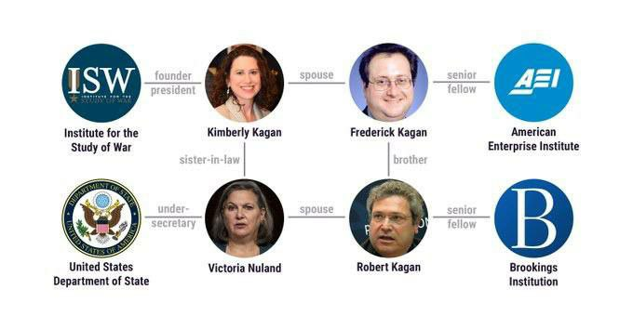
A Small Sample of the Blob’s Influence Network: The Kagan Clan

Slide 32
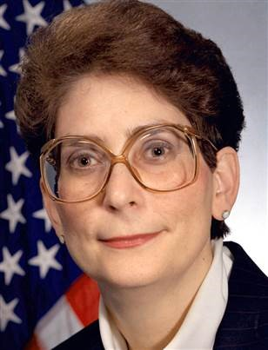
A Rare Stealth Corruption Failure The U.S. Aerial Tanker Saga – Part I
U.S. establishes requirement to replace aerial tanker fleet (2000)
Boeing proposes costly lease deal for tankers
Lease deal supported by Darleen Druyun, Air Force Undersecretary for procurement (2002)
Druyun takes job at Boeing with $250,000 annual salary and $50,000 signing bonus (2003)
Druyan convicted of conspiring with Boeing and sentenced to 9 months (2004)
Boeing CFO, Michael Sears fired (2005)
Boeing CEO, Phil Condit resigns (2005)
Darleen Druyun
Notes:
I wanted to title this slide “The Banality of Grifting,” but I decided not to editorialize. Note the relatively trivial amount of the bribe needed to secure a multi-billion dollar contract. Also note that Boeing was not punished as a corporation, and, as will be shown in the next slide, ended up winning the tanker business. Incidentally, Druyun will collect her Federal pension.

Slide 33
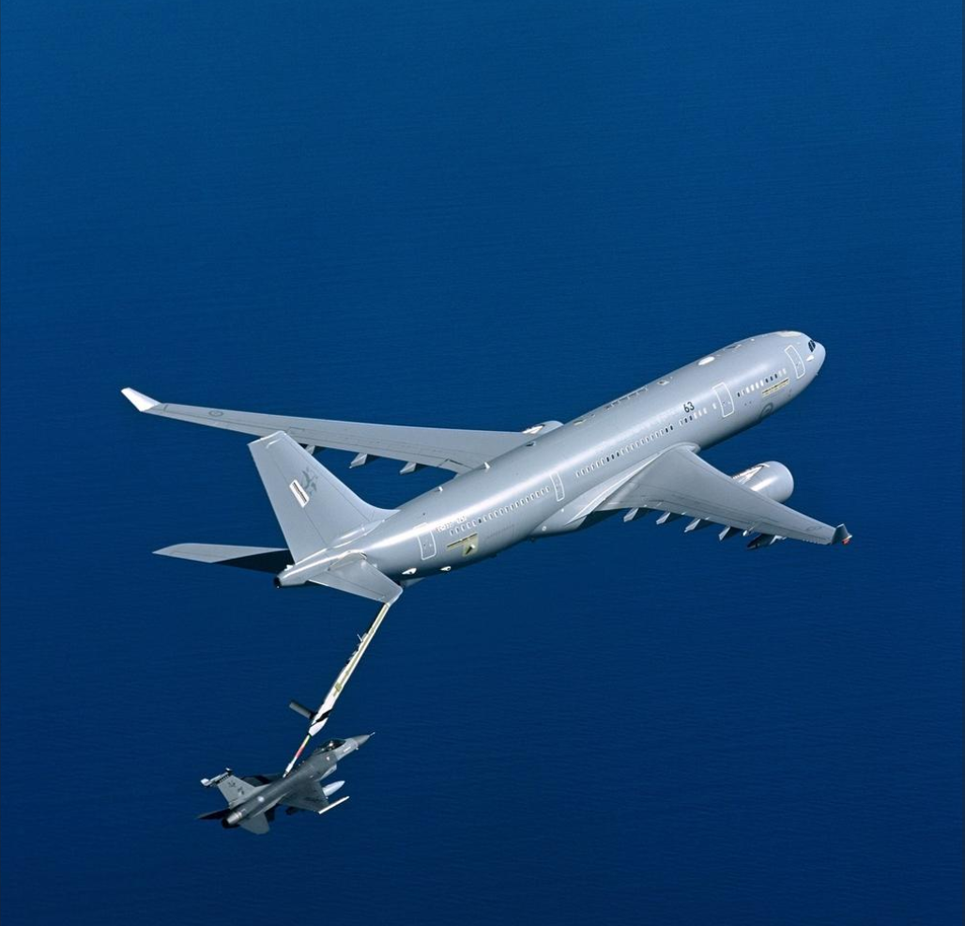
Boeing Wins the Long Game: The U.S. Aerial Tanker saga – Part II
2006 Air Force cancels Boeing tanker contract
2008 U.S. awards new tanker aircraft contract to Airbus/Northrup Grumman
Boeing protests contract award and wins rebid decision
2008 U.S. Air Force reopens tanker contract competition
2011 Boeing wins tanker contract
2014 Boeing KC-46 makes first test flight, problems found
2019 First KC-46 deliveries to USAF, continuing problems reported
2022 KC-46 still not fully mission capable because of unresolved problems with refueling system
Total estimated KC-46 program cost: $43 Billion
Notes:
There has been some rough justice, in that Boeing has had to pay out over $5 billion in cost overruns from the fixed-price contract, but the Air Force still does not have a usable tanker aircraft.

Slide 34
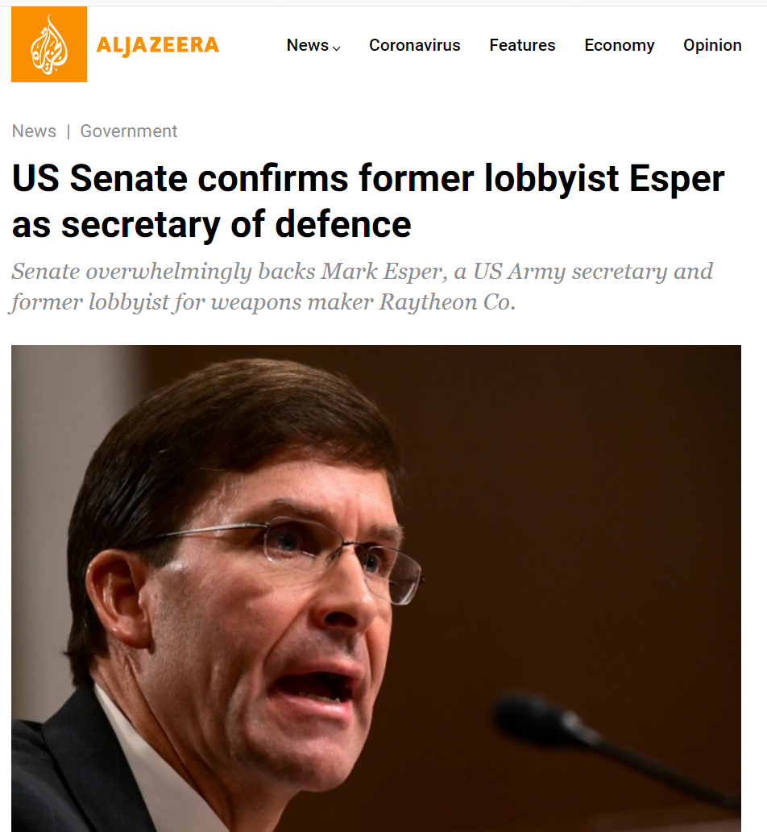
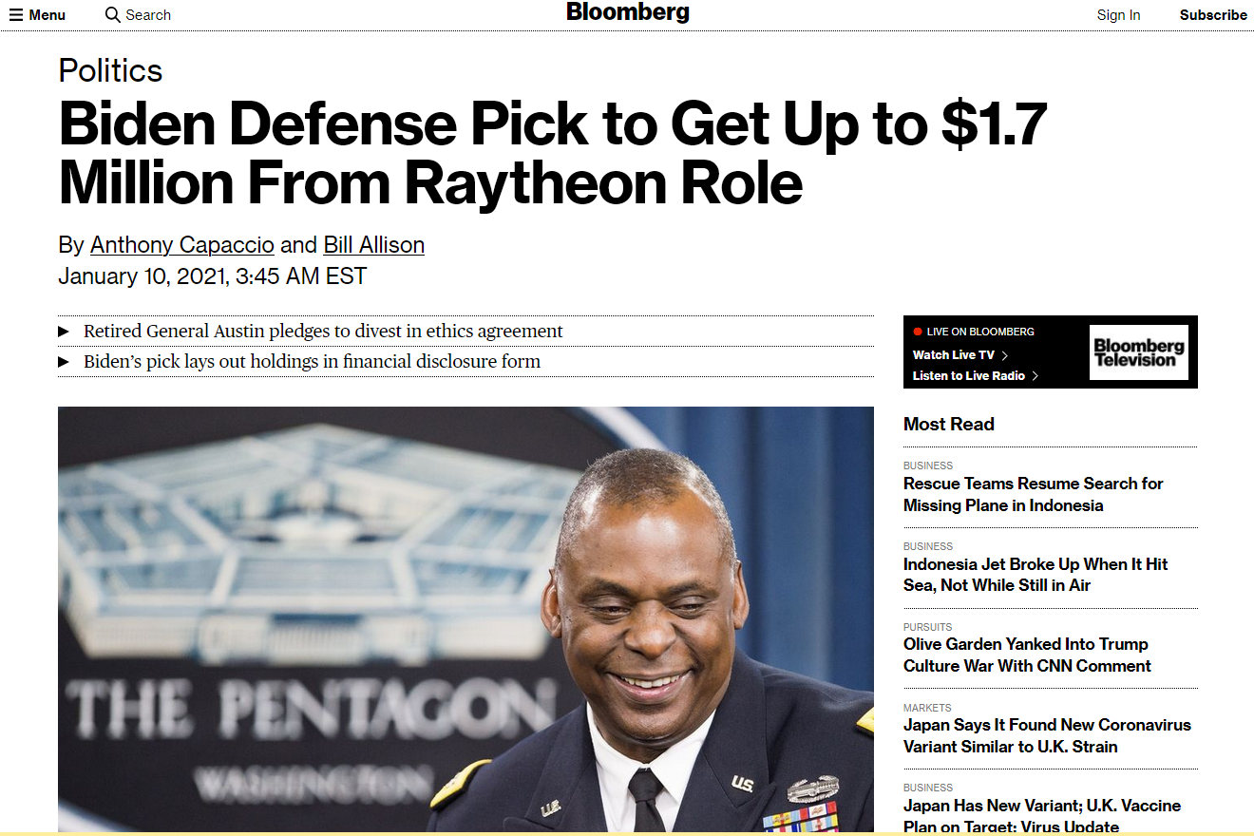
The Revolving Door Spins
2019
2021
Mark Esper worked as vice president of governmental relations for Raytheon from 2010 to 2017.
Lloyd Austin was a member of the Raytheon board of directors from 2016 to 2021.

Slide 35
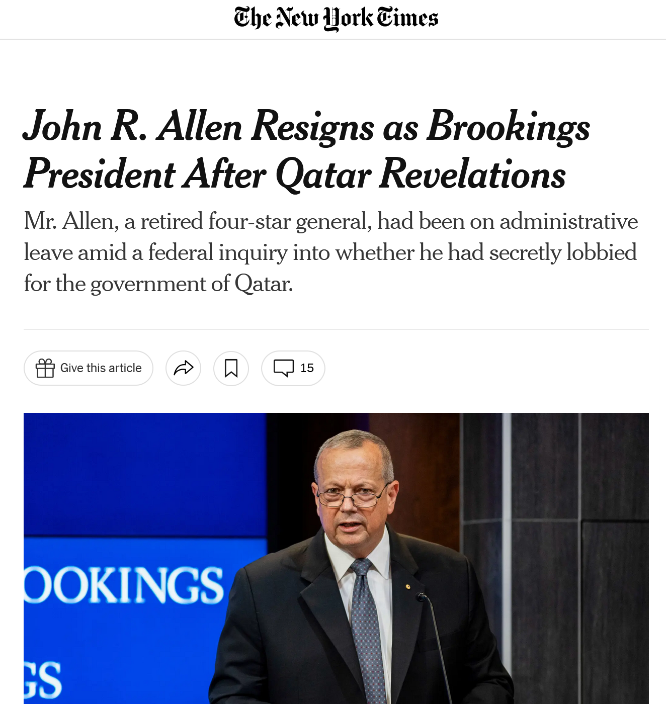
The Latest Blob Embarrassment: Brookings Head Resigns
Typical Blob career progression: from military, to lobbying, to think tank
Allen retires as four-star general
Under investigation for illegal lobbying for government of Qatar
Appointed head of “independent” Brookings Institution think tank
Resigns after disclosure of investigation
NYT 6/12/2022

Slide 36
Anatomy of the Blob Combined Financial and Influence flows
Academia
Think Tanks
Media
$ 100 M
Investors
Influence
U.S. Taxpayers
U.S. Congress
$4.5 T
Defense Industry
$14 M
$800 B
Intelligence Agencies
Defense Dept.
State Dept.
$600 B
$ 1 B
$$$ ?
$100 B
$ 180 M
Foreign Governments
All amounts estimated for 2021

Slide 37
Where is the Blob vulnerable?
The Congressional committees controlling funding
A small number of house and senate members control the defense budget
Campaign funding is vital to securing and holding seats in Congress
The corporate funding of key politicians
Citizen action against arms makers funding campaigns
ESG institutional investor activism against politically active arms makers

Slide 38
How Congress Funds the Military
Committee | House Members | Senate Members
Appropriations | 59 | 30
Armed Services | 59 | 24
Party leaders control committee appointments
Committee chairs control committee agenda
Blob campaign donors protect Blob-friendly committee member seats
Average cost of campaign for House seat: $2 M

Slide 39
Arms Vendors Are Vulnerable To Public and Investor Pressure

Slide 40
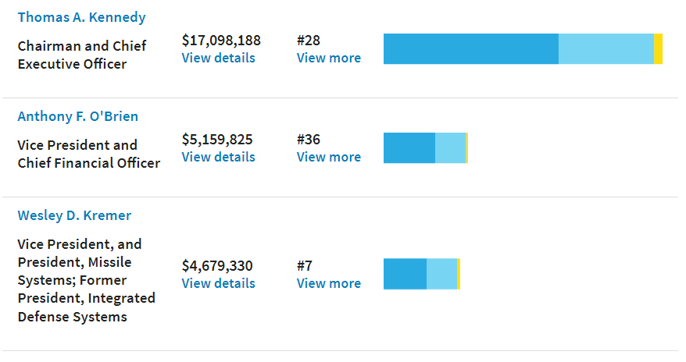
Raytheon Top Management Compensation 2018

Slide 41
Targeted Divestment: A New Way to Fight the Blob
Executives are increasingly compensated by stock options and grants
Pay raises and bonuses are tied to stock price targets
Lowering the stock price directly impacts the earnings of top management
Divestment of stock by large investment institutions can change the behavior of senior management
Public investment institutions are increasingly using social responsibility as an investment criterion
Weapons makers have a social responsibility for the use of their products
Targeted divestment campaigns can potentially alter the behavior of weapons makers
Peace Activists
Investors
Defense Industry

Slide 42
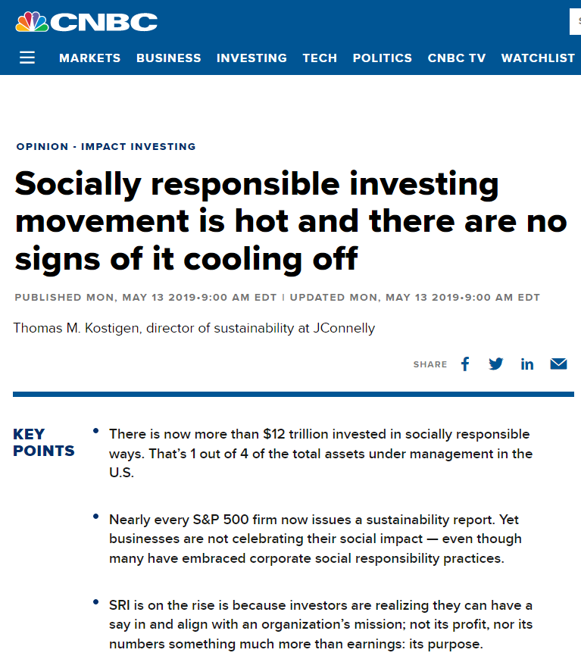
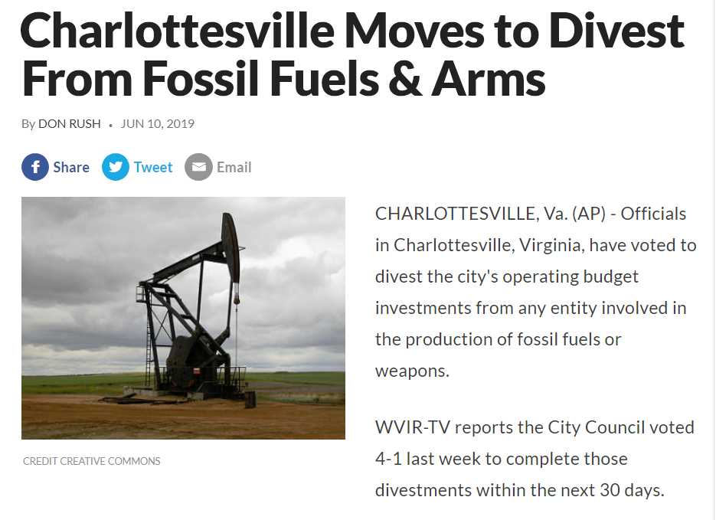
The Rise of Socially Responsible Investing

Slide 43
Strategy for Targeting Blob Vulnerabilities
Target congressional committees funding the military
Support campaigns to remove Blob-friendly incumbents on defense funding committees
Educate public on role of House Speaker and committee chairpersons in controlling committees
Target corporate funding of Blob components
Citizen protest actions against arms makers
Prohibition of political contributions from arms makers
Ban revolving door careerism
Exclusion of arms makers from ESG investment portfolios

Slide 44
The Future of the Blob
The Blob will be defeated in the long term
Economic damage resulting from Blob foreign policy will become unacceptable
Blob-directed military misadventures will lead to disastrous losses
Peace activists will become increasingly effective in discrediting the Blob
The Blob will be attacked from both the political left and the right

Slide 45
Economic Damage
Backfiring of economic warfare
Undermining of dollar reserve currency status
Excessive miliary expenditures

Slide 46
Military Disaster
The Blob is preparing for war with China
China has the resources and weaponry to defeat the U.S. military
Simulations indicate U.S. would lose a conventional war with China
Possibility of nuclear escalation

Slide 47
Peace Activists Become More Effective
The Case For Concentrated Effort
Codepink
WBW
UNAC
GPAX
AFSC
.
.
.
.
.
DIVESTMENT
Defense Industry
Coordinated divestment campaigns can alter corporate behavior
Unified action is the key to building an effective us peace movement

Slide 48
Blob Attacked from Political Left and Right
Peace activists
Environmentalists
Social Justice activists
Libertarians
America First populists
Plutocrats

Slide 49
Summary
The Blob is a group of elites controlling U.S. foreign policy
The ideology of the blob is militaristic pursuit of liberal hegemony
The Blob’s actions have resulted in costly and destructive failures
The Blob has avoided accountability and remains in control
Understanding the structure of the Blob requires determining patterns of financial and influence flows
Knowledge of the Blob’s structure enables more effective opposition to its actions
The Blob is vulnerable in its funding mechanisms
The Blob will ultimately be discredited and driven from power
Defeat of the Blob should be a primary GP objective

Slide 50
Q & A

